Slide 1
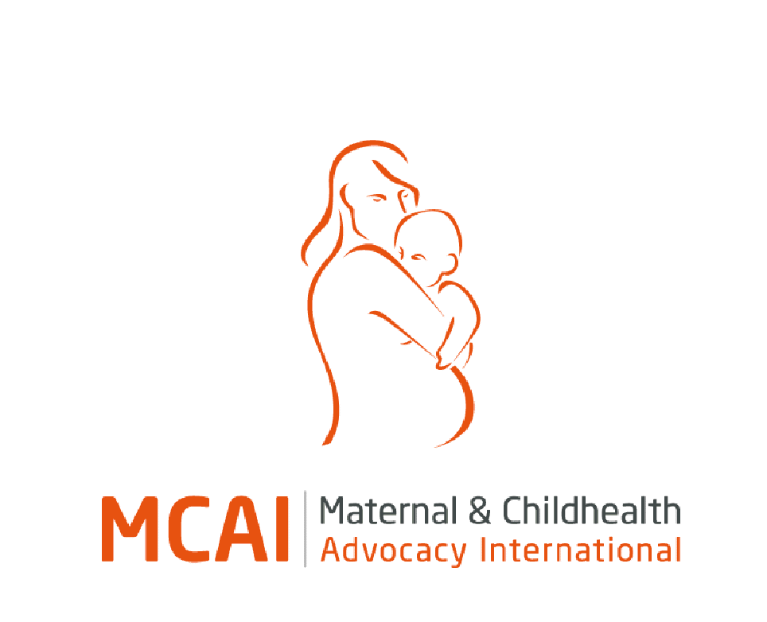
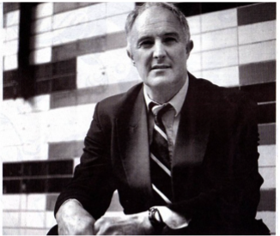







Professor David Southall OBE, MD, FRCPCH
Consultant Obstetrician Liberia and Professor of Paediatrics UK
Honorary Medical Director Maternal and Childhealth Advocacy International (MCAI), 1 Columba Court, Laide IV22 2NL, UK. Registered as a SCIO (Scottish Charitable Incorporated Organisation) No. SC043467
Mobile and WhatsApp numbers +44 (0) 7710 674003 and +44 (0)7944 632011
https://www.mcai.org.uk/
Director, MCAI Liberia, Field Office, House 13, Phebe Hospital, Liberia Enterprise Number 051730402
International clinical and advocacy work undertaken with the organisations below

Slide 2
Helping to improve hospital paediatrics in low resource countries and those where armed conflict
Publications, videos, and books on emergency care for pregnant women, babies and children
Focus on systems for the protection of children from abuse
End of life care for children with untreatable illnesses
Pain control in infants and children in hospital
Task-sharing of train senior nurses to undertake major paediatrics and neonatal emergency care, including non-invasive ventilation
Links to books on neonatal and paediatric care:
The Maternal and Child Friendly Healthcare Initiative (MCFHI) A manual for health workers based on a medical ethics approach to healthcare
Neonatal handbook 2021; updated 2024.
Handbook 1 Hospital care of emergencies in infants and children in low resource and conflict settings August 2021
Handbook 2 Hospital care for children with severe injuries and illnesses August 2021

Slide 3
Helping to improve hospital obstetrics in low resource countries and those where armed conflict
Publications, videos, and books on emergency care
Focus on systems for the protection of women from abuse
New developments involving the management of life-threatening postpartum haemorrhage and the use of portable ultrasound scanning in pregnancy, labour and delivery
Task sharing of midwives to undertake major obstetrics, including surgical treatments such as Caesarean section and repair of ruptured uterus.
Task sharing where mothers are trained to undergo fetal heart rate monitoring on their unborn babies during labour.
Link to textbook on hospital obstetric care 2026:This 2026 version Includes major updates on post-partum haemorrhage, portable ultrasound scanning, blood transfusion, major trauma and vascular access.
A proposed new convention on the rights of pregnant women and girls and their newborn infants (main paper in Archives of Disease in Childhood Jan. 2012) Power-Point presentation

Slide 4
Global advocacy for protecting the rights to health of women, babies and children
Provision over the last 30 years of humanitarian medical aid for pregnant women, babies and children in the following countries: Bosnia, Kosevo, Albania, Sri Lanka, Pakistan, Afghanistan, Liberia and Ukraine
Advocacy concerning the need to re-construct the UN Security Council so that it can effectively protect countries such as Ukraine, Syria, Israel (Gaza) from the devastating effects of armed conflict
Campaigning for better regulation of the international trading in weapons

